Slide 1
Beta Release Presentation
By Matt Norwood

Slide 2
Sample portion of my paper
Section Title: Feeding the Machine: How Big Data Powers AI and Reshapes Society
Conclusion to section:
With the transformation of data in terms of size, scale and complexity over the course of time has brought with it new challenges. From the rise of the tech giants and the ways in which big data gathered by tech giants shape and are used by governments to push various agendas. As well as how big data is constructed and the issues with implementing and storing big data. While the utilization of big data by firms and governments is out of the hands of the average person, these types of power imbalances were never new to begin with. As more and more people become informed by these types of technological power imbalances people will start to speak out against these issues. One of these issues that have raised vocal concern around the internet is how social media consumers are affected by the use of AIs, becoming their own downfall by being the ones to feed these machines with big data.

Slide 3


Have I met my proposed requirements?
I have gotten myself into a much deeper rabbit hole than I have expected. While this might seem like a bad thing, this new direction is much more fresh and a project that I can truly call my own. This paper truly shows off my diverse education at Cornell College, talking about not just the technical details of AI, but expounding upon why they are important and what this means for the future of humanity..

Slide 4

Methodology
This project taught me what are the best and worst ways to write a research project

Slide 5

Bad Way
Here is my take on how to write a research paper as slow as possible
Read, read, read and read
Don’t write at all
Make sure not to have a point in mind and let the research dictate why you write

Slide 6
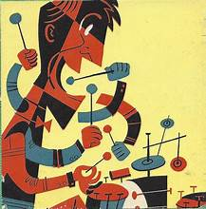
Good Way
Here are are some ways to write a research paper
Have a point or topic of interest
Write what you have on your mind even before reading research
Go with the flow of the paper, you can't organize what isn't there

Slide 7
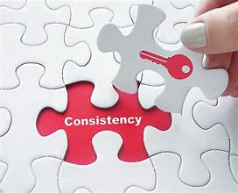
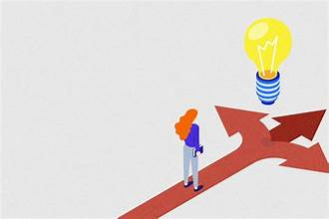
Project management
Made consistent work each day.
Made quick decisions.
Not second guessing myself.

Slide 8

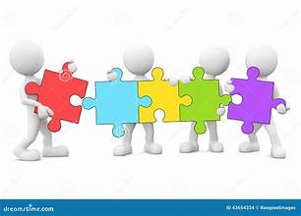
Skills Learned
One skill that I learned was how to read way faster and what info to look for.
Another skill is being able to organize my thoughts and link abstract ideas into something that is interesting and unique.

Slide 9


Problems I overcame
Computer did not work so I had to use my phone
Another problem that I had to overcome was not having access to many reachsearch articles as they were locked behind a paywall. I solved this problem by finding other sources and news articles.

Slide 10
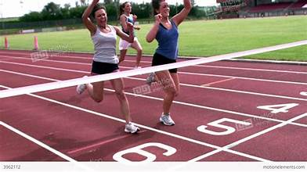
Moving forward
If I had more time on my project I would go more in depth into the technical details but as I only have a few days left I cannot afford that. I am at the final stretch of my paper where I just need to grind and stay up at night in order to finish.

